Slide 1
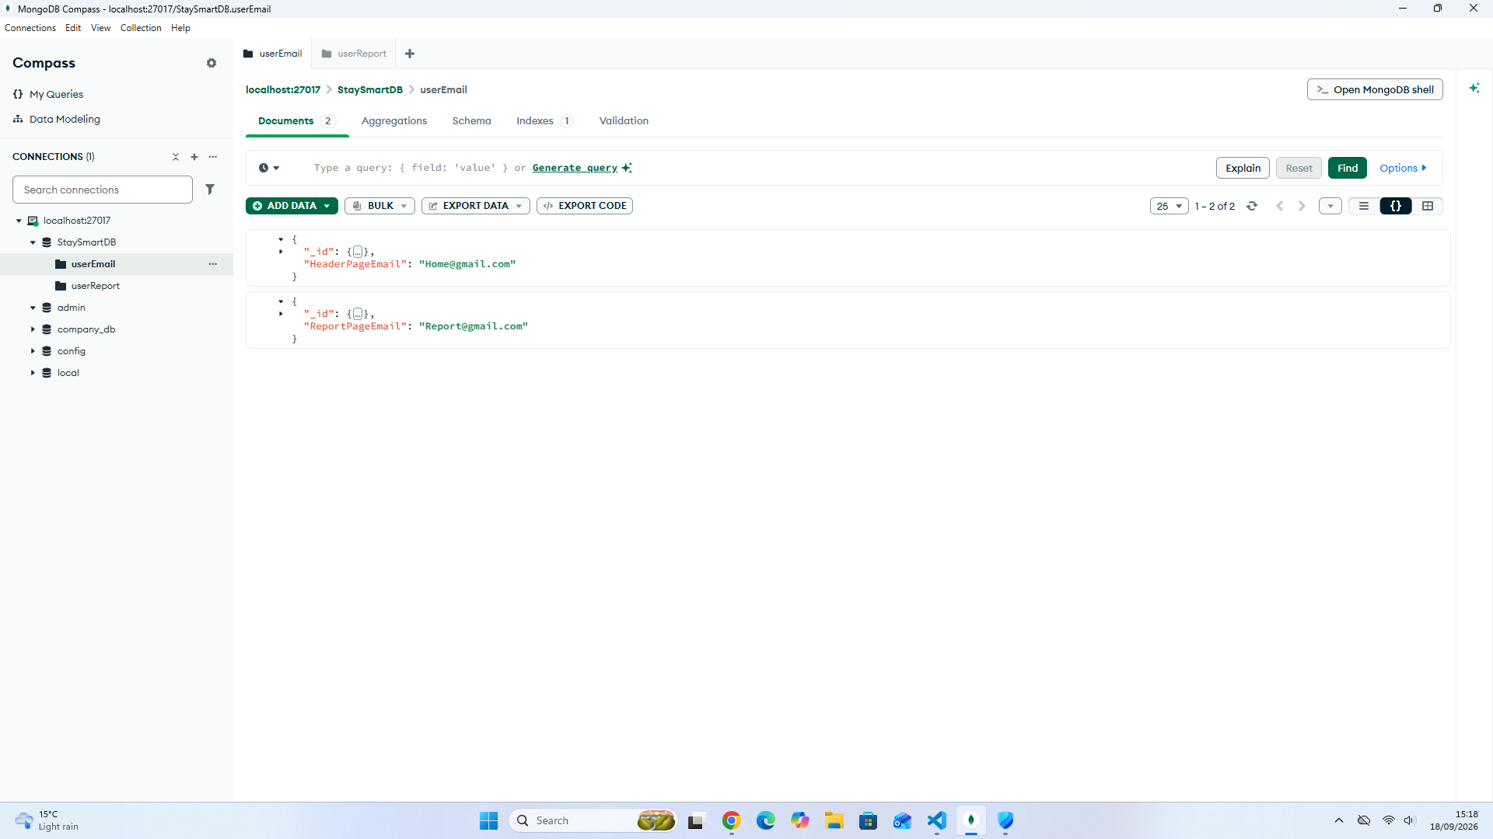

Slide 2
I have set up different db collections
I have 3 collections:
UserEmail
UserReport
thanksEmail

Slide 3
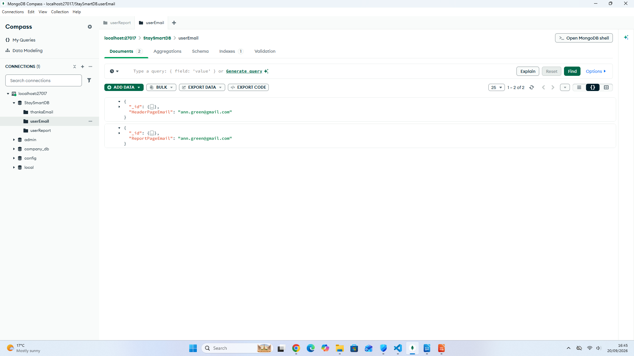

Slide 4
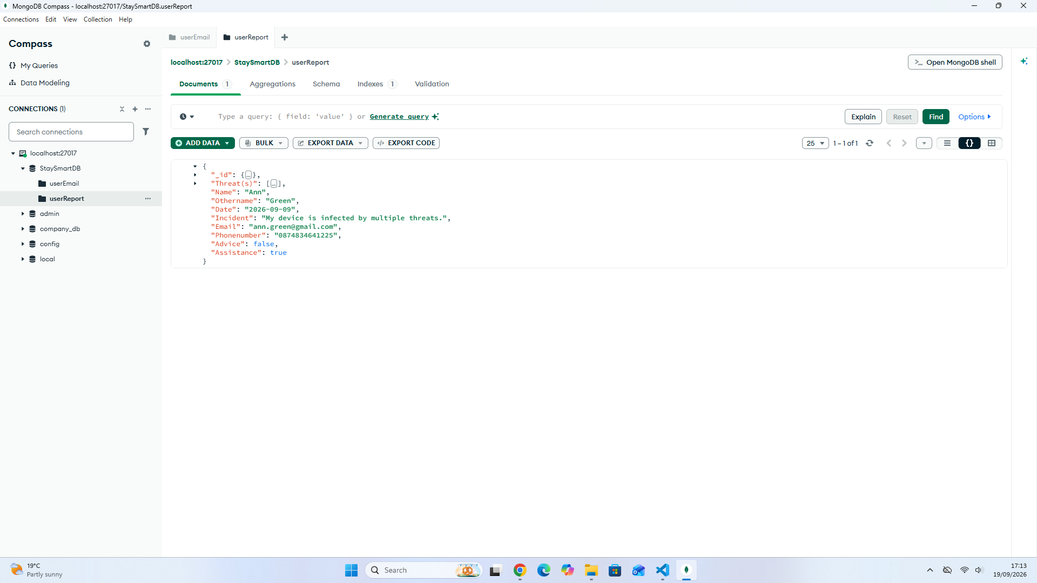

Slide 5
